Slide 1
Working with OPP Resource Files

Slide 2
Agenda
General Information
Creating New Resource Files
Populating a Resource File
Assigning Resource Files to an OPP Project

Slide 3
General Information
Resource files generally represent people, material or travel (or other direct costs – ODC). A Resource file must be created and attached to all projects that will be integrated with Cobra. Initially the file will empty. If integrated with Cobra, the Resource file should be populated with the Budget Elements contained in the Cobra Budget Element file. Note: the term Resource in OPP is equivalent to Budget Element in Cobra. The file must match the Budget Elements contained in the Budget Element breakdown structure in Cobra. There is a 20 character limit for the code. Generally, one Resource file is created for each Master program in Cobra. The more files you have, the more maintenance required. Only one Resource file can be assigned to a project at any given time. Changes to the Resource file affect all the projects that have the file assigned.
The standard format of the Resource file for each element is: Business Unit.Location.Resource Subcategory (for example, 9S.7S.0EE)
When naming a Resource file is it important to adhere to the CSPR naming convention standards. It is recommended to use the following structure: ProgramName_Contract_Res

Slide 4
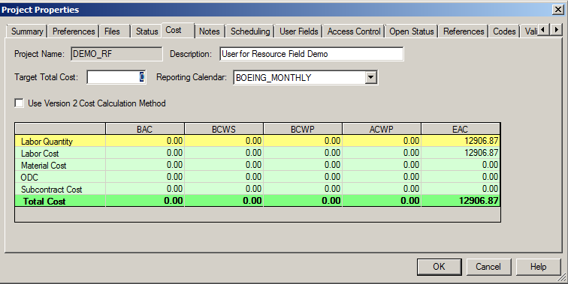
General Information Cont.
When assigning resources to a project, a reporting calendar must be attached to the project through the Processes ribbon > Properties > Cost tab. The default CSPR 3 reporting calendar is called BOEING_MONTHLY and can be selected from the pull-down menu. Using the incorrect reporting calendar in a project can result in the appearance of incorrect monthly or weekly values therefore it is highly recommended to use the BOEING_MONTHLY reporting calendar.

Slide 5
General Information Cont.
Resource files can be populated in several ways – manually, import scripts or OPP/Cobra mapping tool.
If using the OPP/Cobra mapping tool,
The OPP project must be associated to a Cobra program. CSPR Options is used to establish this relationship.
In order to “pull over” the resources (budget elements) must be coded properly in the Cobra tool. The Cobra Budget Element Breakdown file must be flagged with “OPP”.
In order to update the resource code file, the user must have WRITE access to the file.

Slide 6
Creating New Resource Files
Creating New
Creating New as Copy of Existing

Slide 7
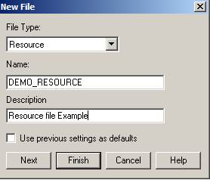
Creating a New Resource File
Follow the steps below to create a New Resource Code file for your OPP Project.
From the Open Plan Explorer, select File>New>Resource File
The New File box opens with File Type ‘Resource’ already selected
Type in the desired Name based on the CSPR 3 naming convention & no spaces
Type in the Description
Click Next

Slide 8
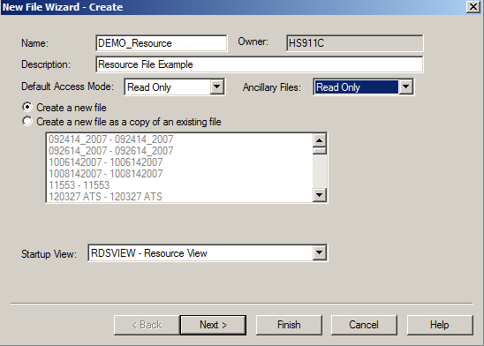
Creating a New Resource File
The New File Wizard – Create box opens
Change the Default Access Mode to ’Read Only’
Change the Ancillary Files access to ‘Read Only’
Select the Create a new file option
Keep default Startup View
Click Next

Slide 9
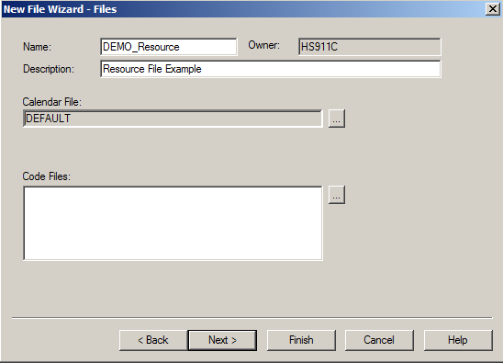
Creating a New Resource File
The New File Wizard – Files box opens
If you had any ancillary files to attach to this new file, you’d do it here. We will skip this step
Click Next

Slide 10
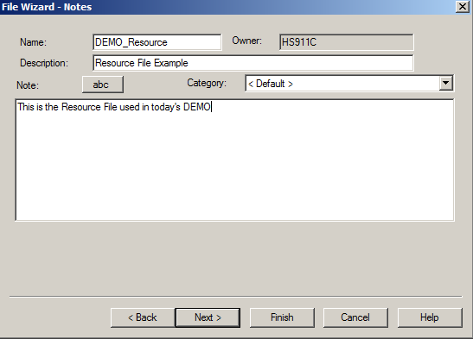
Creating a New Resource File
The File Wizard – Notes box opens
Type any desired notes here
Click Next

Slide 11
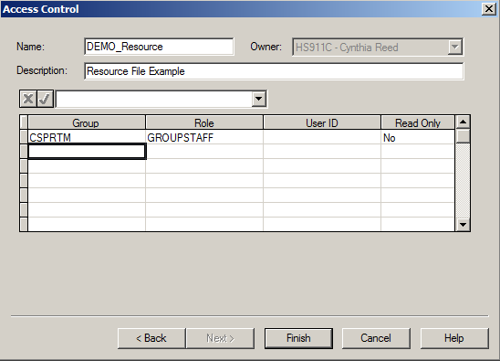
Creating a New Resource File
The Access Control box opens
Assign the appropriate access for the code file
Click Finish
Notes:
Note: Adjust your Read Only selections appropriately. Not all groups should have Read Only set to ‘No’. This gives the group ‘Write’ access to the file.

Slide 12
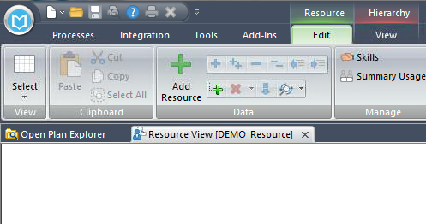
Creating a New Resource File
The resource code file has been created and will open to an empty view
Click File>Save to save the newly created resource code file

Slide 13
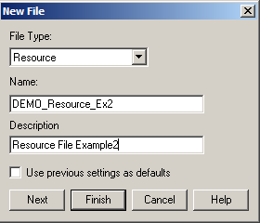
Creating New as Copy of Existing Resource
Follow the steps below to create a New Resource Code file for your OPP Project.
From the Open Plan Explorer, select File>New>Resource File
The New File box opens with File Type ‘Resource’ already selected
Type in the desired Name based on the CSPR 3 naming convention & no spaces
Type in the Description
Click Next

Slide 14
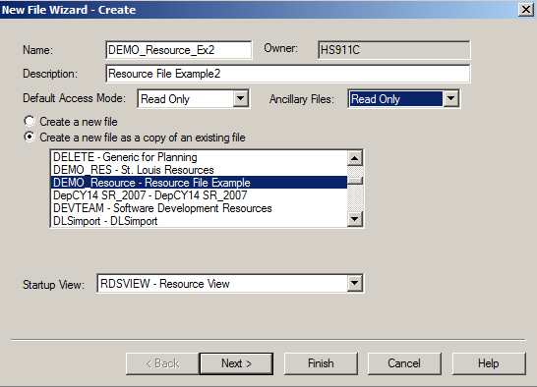
Creating New as Copy of Existing Resource
The New File Wizard – Create box opens
Change the Default Access Mode to ’Read Only’
Change the Ancillary Files access to ‘Read Only’
Select the Create a new file as a copy of an existing file option
Select an existing resource file to copy
Keep default Startup View
Click Next

Slide 15
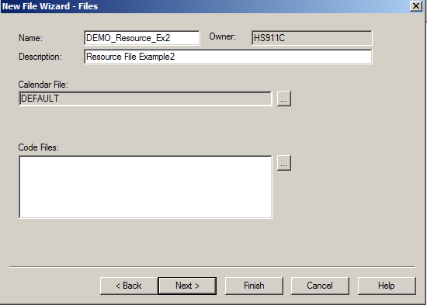
Creating New as Copy of Existing Resource
The New File Wizard – Files box opens
If you had any ancillary files to attach to this new file, you’d do it here. We will skip this step
Click Next

Slide 16
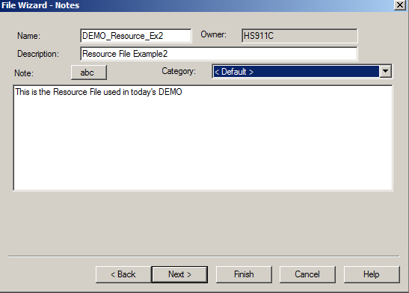
Creating New as Copy of Existing Resource
The File Wizard – Notes box opens
Any notes from the file you copied will be displayed, update as desired
Click Next

Slide 17
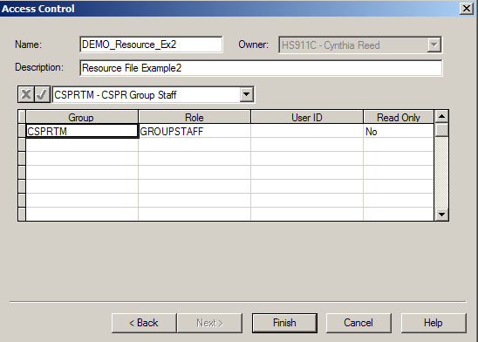
Creating New as Copy of Existing Resource
The Access Control box opens
Any access from file copied will be displayed, updated as required for this code file
Click Finish
Notes:
Note: Adjust your Read Only selections appropriately. Not all groups should have Read Only set to ‘No’. This gives the group ‘Write’ access to the file.

Slide 18
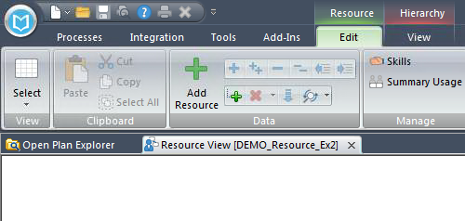
Creating New as Copy of Existing Resource
The resource code file has been created and will open to an empty view
Click File>Save to save the newly created resource code file

Slide 19
Populating a Resource Code File
Manually Populate via Details Box
Manually Populate via Spreadsheet View
Import from Excel to Populate
Use OPP/Cobra Mapping Tool to Populate

Slide 20
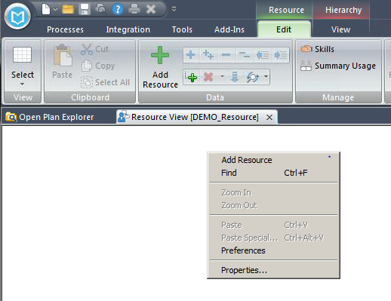
Manually via the Resource Details Box
Open the resource code file in Exclusive mode
The code file will open & appear as an empty screen
Double click in the blank white area, or right mouse click and select Add Resource, or select the Edit ribbon, ‘+’ Add Resource
Notes:
Manually adding resource IDs is highly discouraged if you are working with a project that is associated with a Cobra project. Then the OPP/Cobra mapping tool must be used for any Adds/Updates to the Resource IDs.

Slide 21
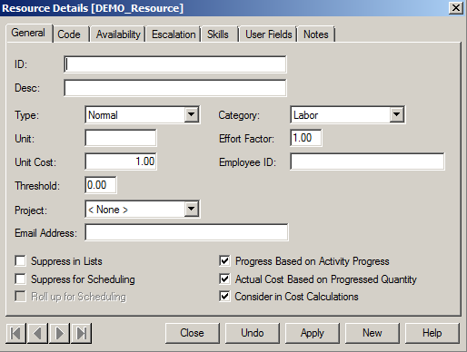
Manually via the Resource Details Box
The Resource Details box opens
The General Tab on displays the basic information about each resource
Type in the ID (resource ID also called Budget Element (BE) for Cobra users) and Description
The ID (resource ID) is an alphanumeric code unique to the resource. Periods are used to indicate hierarchical levels
Click either Apply to add the code to the file
Notes:
Manually adding resource IDs is highly discouraged if you are working with a project that is associated with a Cobra project. Then the OPP/Cobra mapping tool must be used for any Adds/Updates to the Resource IDs.

Slide 22
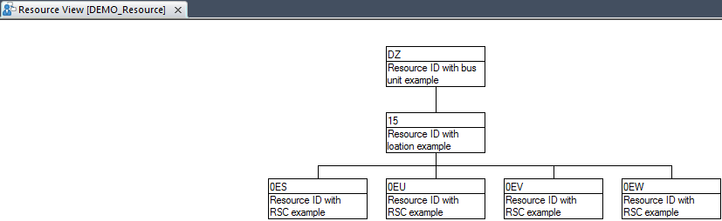
Manually via the Resource Details Box
Select New if adding additional resources or select Close if finished
Note – you will receive an error if the parent portion of the ID is not already in the code file
The resource code(s) will appear as seen in the pic below
Notes:
Manually adding resource IDs is highly discouraged if you are working with a project that is associated with a Cobra project. Then the OPP/Cobra mapping tool must be used for any Adds/Updates to the Resource IDs.

Slide 23
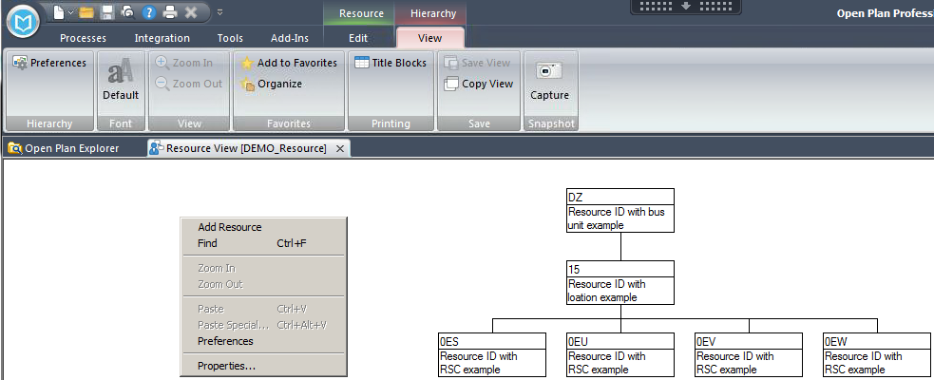
Manually via the Resource Details Box
The Res ID will only display the ‘child’ portion of the ID, by default.
To display the entire ID, right mouse click in the blank portion of the open view and select Preferences, or from the View ribbon, select Preferences
Child portion of ID only
Notes:
Manually adding resource IDs is highly discouraged if you are working with a project that is associated with a Cobra project. Then the OPP/Cobra mapping tool must be used for any Adds/Updates to the Resource IDs.

Slide 24
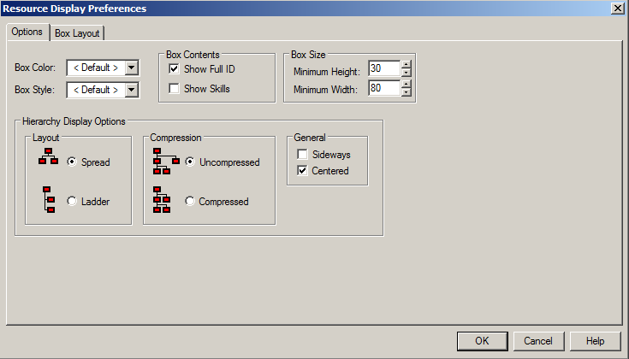
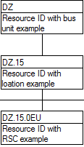
Manually via the Resource Details Box
The Resource Display Preferences box opens
Check the Box Contents option to Show Full ID
Click OK
Note: other display options may also be selected in the Resource Display Preferences box, customize as needed
Now we see the full Res ID
Notes:
Manually adding resource IDs is highly discouraged if you are working with a project that is associated with a Cobra project. Then the OPP/Cobra mapping tool must be used for any Adds/Updates to the Resource IDs.

Slide 25
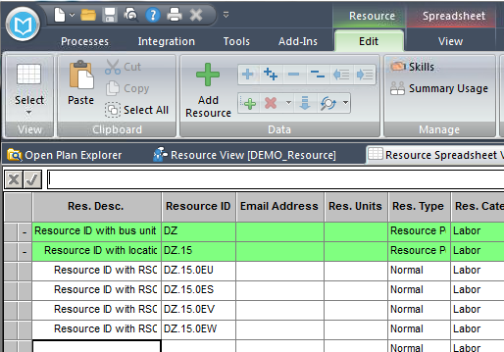
Manually via a Spreadsheet View
Res IDs can be manually entered into a spreadsheet view as well.
Open the Resource File in exclusive mode
Open the ResourceSpreadsheet view (attach if necessary)
Type in the Res ID and Desc for all new IDs
All other fields will populate with default settings
When done, save your updates (File>Save)
Notes:
Manually adding resource IDs is highly discouraged if you are working with a project that is associated with a Cobra project. Then the OPP/Cobra mapping tool must be used for any Adds/Updates to the Resource IDs.

Slide 26
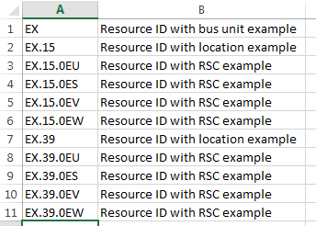
Importing from Excel
Code Files can be quickly populated by importing the code data from an Excel file.
Create an Excel file with the desired Resource information. The file should contain the resource code in column A, and the resource code description in column B. There should be no headings in the files, and no commas in the ID or description
Notes:
Importing Res IDs is highly discouraged if you are working with a project that is associated with a Cobra project. Then the OPP/Cobra mapping tool must be used for any Adds/Updates to the Resource IDs.

Slide 27
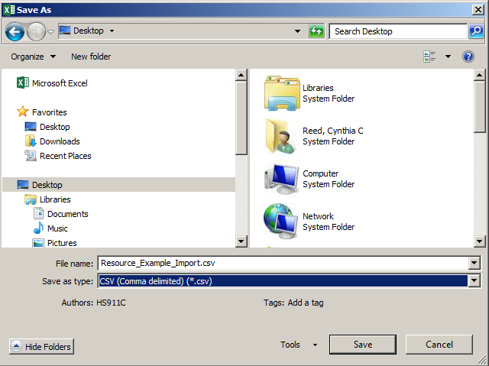
Importing from Excel
Perform a File>Save As (change type to .csv) to a location you can access via Citrix, then click Save
Notes:
Importing Res IDs is highly discouraged if you are working with a project that is associated with a Cobra project. Then the OPP/Cobra mapping tool must be used for any Adds/Updates to the Resource IDs.

Slide 28
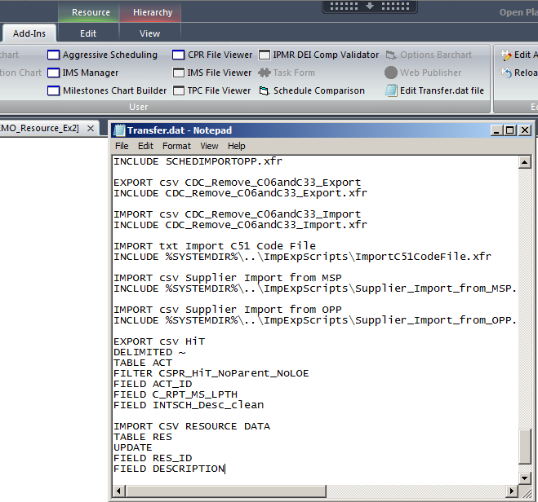
Importing from Excel
Update the User.dat file located in your CSPR user folder with a script to import the contents of the Excel file. This script will be available the next time you log into OPP. The script can also be copied and saved into the Transfer.dat file, accessed from Add-ins ribbon, then Edit Transfer.dat file for immediate use.
Notes:
Importing Res IDs is highly discouraged if you are working with a project that is associated with a Cobra project. Then the OPP/Cobra mapping tool must be used for any Adds/Updates to the Resource IDs.

Slide 29
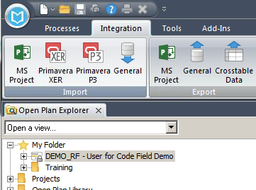
Importing from Excel
To import the contents of the Excel File, first open the resource file in exclusive mode, then open the OPP project in exclusive mode. With the project highlighted, go to the Integration ribbon, and select General from the Import section
Notes:
Importing Res IDs is highly discouraged if you are working with a project that is associated with a Cobra project. Then the OPP/Cobra mapping tool must be used for any Adds/Updates to the Resource IDs.

Slide 30
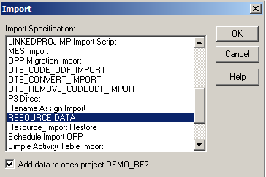
Importing from Excel
The Import box opens.
Highlight the desired Import Specification
Check the box to Add data to open project
Click OK
Notes:
Importing Res IDs is highly discouraged if you are working with a project that is associated with a Cobra project. Then the OPP/Cobra mapping tool must be used for any Adds/Updates to the Resource IDs.

Slide 31
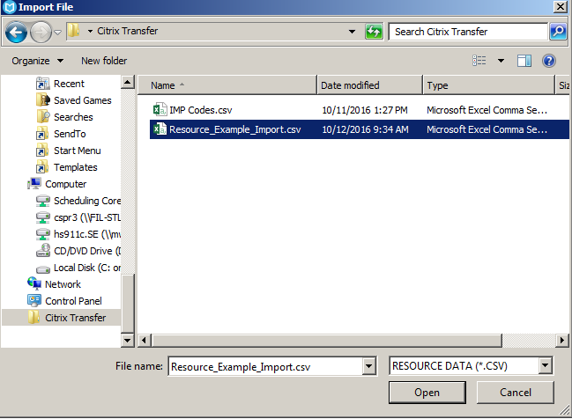
Importing from Excel
The Import File box opens
Drill down to locate the .csv file to be imported
Click on (highlight) the file name
Click Open
Notes:
Importing Res IDs is highly discouraged if you are working with a project that is associated with a Cobra project. Then the OPP/Cobra mapping tool must be used for any Adds/Updates to the Resource IDs.

Slide 32
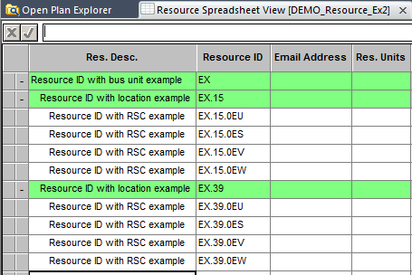
Importing from Excel
The resource file will be updated with the codes and descriptions contained in the Excel (.csv) file.
Save the changes to the code file. (File>Save)
See also: Module 107 – Advanced Import Export
Notes:
Importing Res IDs is highly discouraged if you are working with a project that is associated with a Cobra project. Then the OPP/Cobra mapping tool must be used for any Adds/Updates to the Resource IDs.

Slide 33

Using OPP/Cobra Mapping Tool
The Plug and Play OPP/Cobra Mapping Tool can be used to populate the OPP resource code file with data from the resource table assigned to the associated Cobra project. The resources IDs that will pass from Cobra must be flagged for OPP.
Using the OPP/Cobra Mapping tool will eliminate possible data anomalies between the OPP and Cobra resource IDs. This tool can be used once the OPP project has been associated with a Cobra program.
To import the resource table information from Cobra, first open the resource file in exclusive mode, then open the OPP project in exclusive mode.
Click on the Add-ins ribbon, then CSPR Plug and Play Tools, and double click on the OPP/Cobra Mapping tool icon

Slide 34
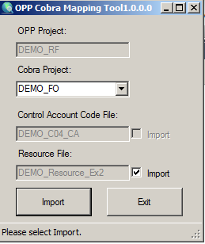
Using OPP/Cobra Mapping Tool
The OPP Cobra Mapping Tool box opens.
Verify the Project box is populated with the correct OPP project
Verify the Program box is populated with the correct Cobra program
Verify the Resource File box is populated with the correct file name
Check the Import box (on right of Resource File box)
Select Import

Slide 35
Using OPP/Cobra Mapping Tool
Import complete will display in the status bar at the bottom of the dialog box once the import has finished

Slide 36
Using OPP/Cobra Mapping Tool
Verify the results of the import in the Resource Code File
If desired resources are missing, check the setup in Cobra is correct and that the OPP flag is present
Save (File>Save)the revisions to the resource code file and the OPP project
Note: If new resource IDs are added in Cobra, the OPP/Cobra Mapping Tool must be run to update the OPP resource code file. If resource IDs are deleted from Cobra and not assigned to any activities in OPP, the resource ID must be manually deleted from the OPP resource code file.

Slide 37
Assigning Resource Files to an OPP Project
Assign using Project Properties
Assign using Drag and Drop

Slide 38
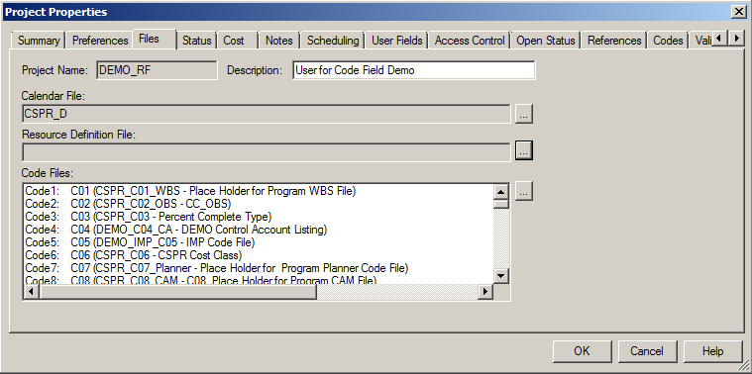
Assigning to Project via Project Properties
Open the OPP project in exclusive mode
From the Processes ribbon, select Properties in the Dialogs section
Select the Files tab inside of the Project Properties window
Click on the ellipsis button next to the Resource Definition File box

Slide 39
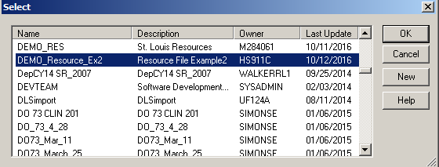
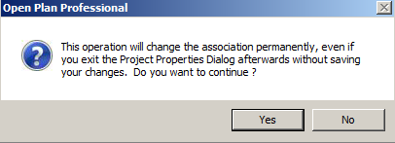
Assigning to Project via Project Properties
A Select box opens
Scroll down and highlight the desired Resource File
Click OK
Information box appears, click Yes to continue

Slide 40
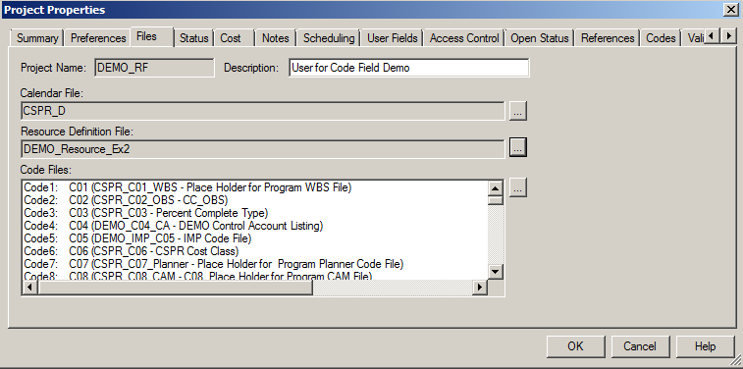
Assigning to Project via Project Properties
The resource code file is now associated to the OPP project

Slide 41
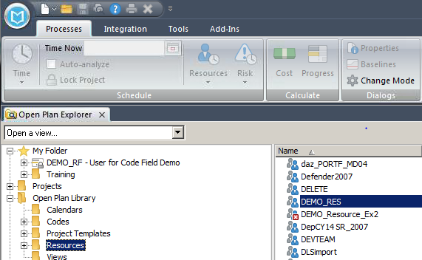
Assigning to Project via Drag and Drop
Open the OPP project in exclusive mode
Highlight the Resources folder in the OPP Library (left pane)
Highlight the resource file to be added (right pane)
Drag the highlighted file from the right and drop it onto the project you have open exclusively (in Open Plan Explorer, on left)

Slide 42
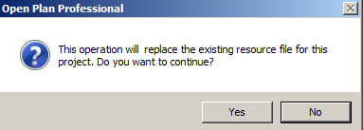

Assigning to Project via Drag and Drop
If a resource code file is already attached, you will receive the message below. Click Yes to replace
The Resource code file is now associated with the OPP project

Slide 43
CHANGE LOG
DATE | SLIDE | DESCRIPTION OF CHANGE
10/12/16 | Most | Updated slides to reflect OPP 8.0

